Slide 1
Service Provider Training Package
November 2024

Slide 2
Service Provider Training
Content
This training package provides education and information to Service Providers and their support staff on the following important Aged Care topics:
Cultural Awareness
Aged Care Code of Conduct
Elder Abuse
SIRS
Deteriorating client
Restrictive Practices
Open Disclosure
Infection Control / Hand Hygiene

Slide 3
Cultural Awareness

Slide 4
Cultural Awareness
Cultural Awareness is understanding the individual differences between people of other backgrounds, races, cultures, religions or nationalities, in order to effectively communicate with people of different cultures.
In our multicultural, diverse country, cultural awareness is an essential skill for everyday life. We have a responsibility to develop awareness of all culture/s, history and traditions, in order to communicate respectfully and effectively.
Cultural awareness is important in the workplace because it ensures that a level of respect is maintained throughout all communications.
Cultural awareness in the workplace can take a number of forms. Examples include:
Knowledge of cultural responses to grief or loss
Understanding family life
Undertaking continual education in the area,
Extensive knowledge of the history of all peoples generally and in a specific area.
Cultural awareness also requires the understanding that all cultures are numerous and diverse, and that a one-size-fits-all approach is never appropriate.

Slide 5
Aged Care Code of Conduct
What is the Code?
The Code of Conduct for Aged Care (the Code) was introduced on 1 December 2022.
The Code:
• sets out how approved providers (providers) and their workers and governing persons must behave and treat consumers when providing aged care services
• strengthens protections for older Australians against unsafe, poor-quality aged care services
Why is the Code important?
The Code aims to improve the safety, health, wellbeing and quality of life of aged care consumers by:
• promoting ethical, honest and respectful behaviour
• building trust in aged care services
• protecting consumers against workers who pose an unacceptable risk of harm.

Slide 6
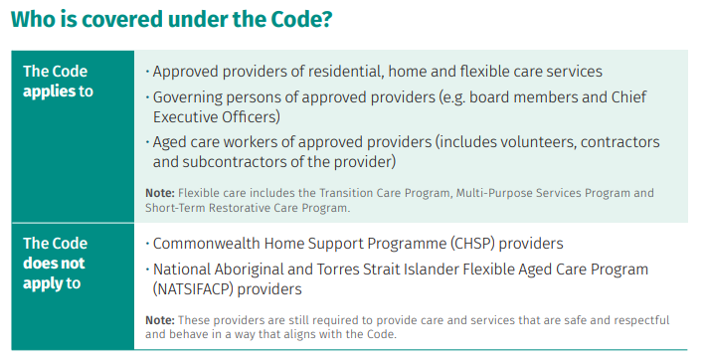
Aged Care Code of Conduct
What is the Code?

Slide 7
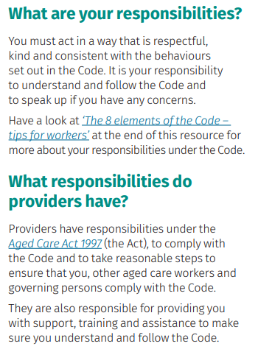
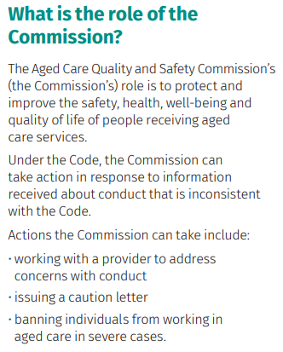
Aged Care Code of Conduct
What is the Code?

Slide 8
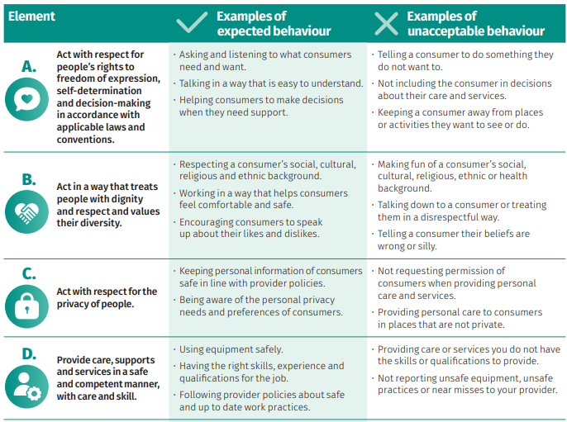
Aged Care Code of Conduct
The 8 elements of the Code

Slide 9
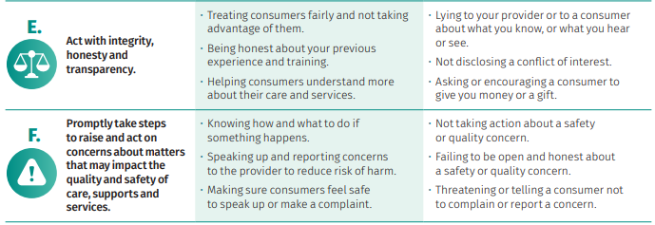
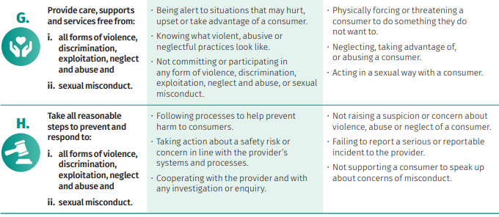
Aged Care Code of Conduct
The 8 elements of the Code

Slide 10
Elder Abuse
What is Elder Abuse?
Elder abuse is a single or repeated act or lack of appropriate action, occurring within any relationship where there is an expectation of trust, which causes harm or distress to an older person (WHO 2022).
Elder abuse occurs in relationships where there is ‘an expectation of trust’. Such relationships include those with family members, friends, neighbours, and some professionals such as paid carers.
In Australia, ‘older people’ are generally defined as those aged 65 and over. However, Aboriginal and Torres Strait Islander people are often included among ‘older people’ from the age of 50 (Kaspiew et al. 2015). These age groups are used to define older people in this page, unless stated otherwise.

Slide 11
Elder Abuse
What is Elder Abuse?
Elder abuse can take various forms:
Physical – unexplained pain, burns, cuts, dislocation, sedation, repeated injury.
Psychological or Emotional – depression, confusion, insomnia, lethargy, changes in eating patterns.
Sexual – older person is reluctant to accept physical touch or personal hygiene, shows fear.
Financial – not paying bills, items going missing, no money for shopping or transport.
Neglect - poor and inadequate care or purposefully withholding of necessary items such as food / drink, untreated physical conditions, dirty living conditions or clothing, ignoring calls for assistance.
If an older person’s rights are not upheld, it is YOUR job to report this.
Your workplace will have procedures to follow when reporting a or check
with your supervisor and report to Community Interlink immediately.

Slide 12
SIRS
We all have a responsibility to help prevent
the abuse and neglect of older people
What is a reportable incident?
Serious incidents that Community Interlink must report to the Commission could be:
• Unreasonable use of force – like kicking, punching or rough handling
• Unlawful sexual contact or inappropriate sexual conduct – like stalking, making sexual advances or unwanted sexual touching
• Psychological or emotional abuse – like yelling, name calling or ignoring
• Stealing or financial coercion by a staff member – like stealing money or pressuring you to give money
• Neglect – like not giving you the care you need to stay well
• Inappropriate use of restrictive practices – like using physical force or medication to restrict your freedom or movement
• Missing consumers – where a care recipient goes missing
• Unexpected death – like someone dying unexpectedly because they did not receive proper care and services.

Slide 13
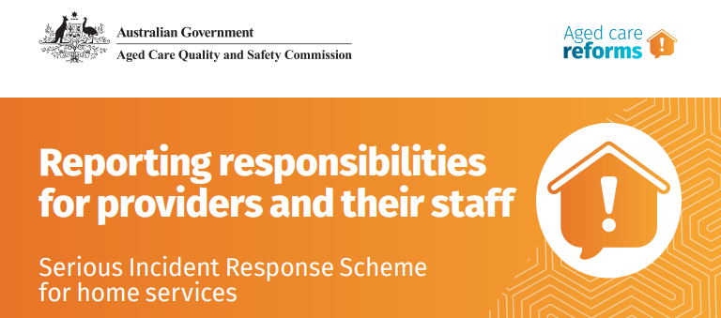
We all have a responsibility to help prevent
the abuse and neglect of older people
ALL Staff members must:
Understand their SIRS responsibilities
Be trained to respond to incidents
Escalate incidents so they can be appropriately managed and documented
Please notify Community Interlink immediately of any potential reportable incidents

Slide 14
Deteriorating Client
Notice the Signs
Deterioration is when a person’s state of health declines.
They may:
become bedbound (stay in bed);
spend more time sleeping or resting;
have reduced intake of food (eat less);
have difficulty with swallowing, or;
have a change in their conscious state
Recognising that a person is deteriorating is important so that:
this can be discussed with the person and their family;
Their care is reviewed with the person (if able), the family and GP;
a palliative care plan or pathway can be started or changed;
care is given in line with the person’s wishes;
symptoms are managed appropriately;
support to the person, the family and staff can be provided.
Support workers often care for people on a daily basis and may notice the first signs of deterioration. Please notify Community Interlink immediately of any deterioration.

Slide 15
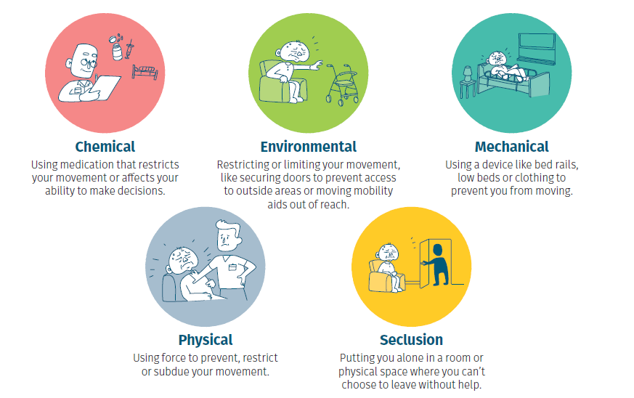
Restrictive Practices
Everyone in aged care has the right to be safe, treated with dignity and respect and receive high quality care and services.
It’s important you understand the rules around restrictive practices.
Restrictive practices limit rights or stop people from doing what you want to do.
Restrictive practices can be:

Slide 16
Restrictive Practices
Everyone in aged care has the right to be safe, treated with dignity and respect and receive high quality care and services.
Restrictive practices refer to any practice or intervention restricting the rights or freedom of people receiving aged care.
If required, restrictive practices must only be used:
in the least restrictive form
for the shortest period
to prevent harm to an aged care recipient or other people
only after careful consideration about how it may affect the aged care recipient,
And never be used as a punishment.
If you are concerned that restrictive practices are being used, please contact the team at Community Interlink immediately.

Slide 17
Open Disclosure
What is Open Disclosure
Open Disclosure is the open discussion that an aged care provider has with consumers when something goes wrong that has harmed or had the potential to cause harm to a consumer.
Open Disclosure refers to the practice of communicating with a consumer when things go wrong, addressing any immediate needs or concerns and providing support, apologising and explaining the steps the provider has taken to prevent it happening again.
Open Disclosure may also involve the consumer’s family, carers, and other support people and representatives when a consumer would like them to be involved.
Please contact the team at Community Interlink immediately if you feel there is an incident that requires the use of Open Disclosure.

Slide 18
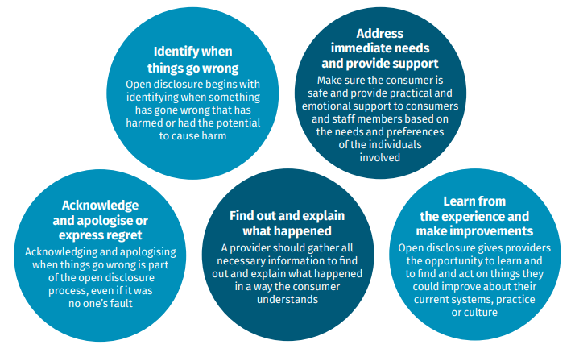
Open Disclosure
There are 5 main elements of Open Disclosure

Slide 19
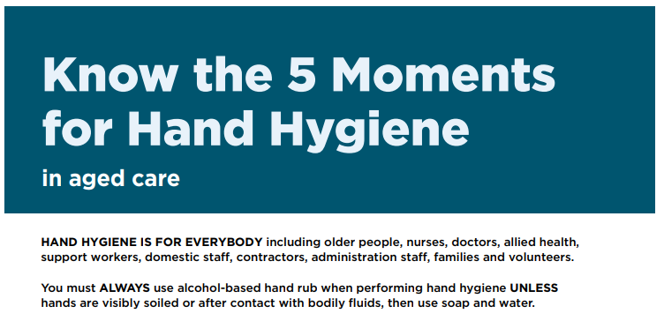
Infection Control /
Hand Hygiene

Slide 20
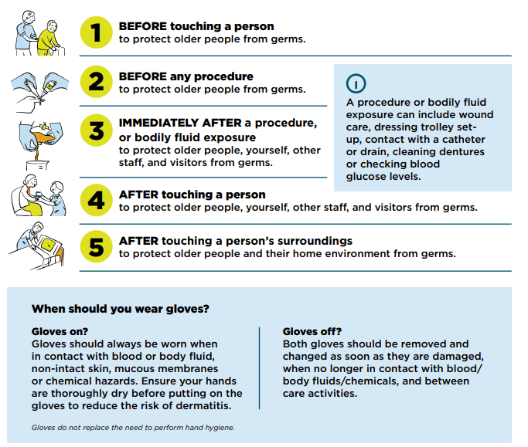
5 Moments for
Hand Hygiene

Slide 21
Additional Aged Care training can be found on the Aged Care Quality and Safety Commission’s online learning portal –
https://learning.agedcarequality.gov.au/user_login

Slide 22
For further questions or feedback please contact Community Interlink
on (03) 5823 6500
Links to additional Aged Care information can be found on our Website
https://communityinterlink.org.au/information-for-businesses/
Information for Businesses - Community Interlink

