Slide 1


Service Provider Training Package
November 2025

Slide 2


Service Provider Training
Content
This training package provides education and information to Associate Providers and their support staff on the following important Aged Care topics:
Aged Care Code of Conduct
Strengthened Aged Care Quality Standards
Statement of Rights
Culturally Safe, Trauma Aware and Healing Informed care
Elder Abuse
SIRS
Deteriorating client
Restrictive Practices
Open Disclosure
Feedback / Complaints
Whistleblower reporting
Advocacy
Infection Control / Hand Hygiene
Food Safety

Slide 3


Aged Care Code of Conduct
What is the Code?
The updated Code of Conduct for Aged Care was introduced on 1 November 2025.
The Code:
• sets out how registered providers (providers) and their aged care workers and responsible persons must behave and treat people when delivering funded aged care services
• strengthens protections for older Australians against unsafe, poor-quality aged care services
Why is the Code important?
The Code aims to improve the safety, health, wellbeing and quality of life of aged care consumers by:
• promoting ethical, honest and respectful behaviour
• building trust in aged care services
• protecting consumers against workers who pose an unacceptable risk of harm.

Slide 4
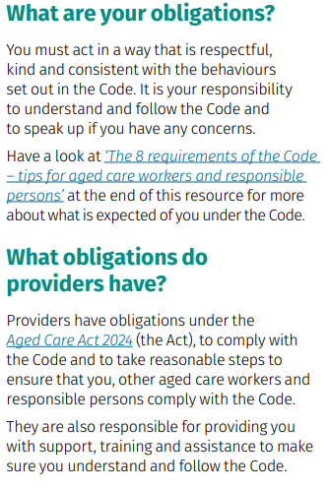
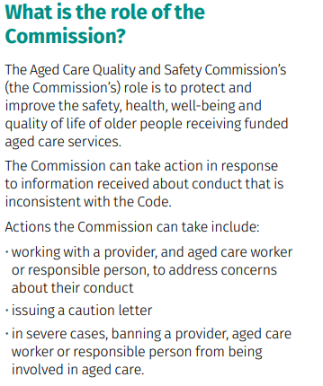
Aged Care Code of Conduct
What is the Code?

Slide 5
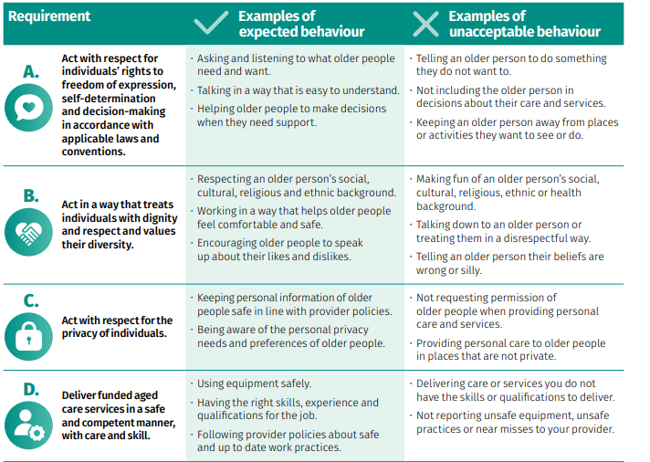
Aged Care Code of Conduct
The 8 requirements of the Code

Slide 6
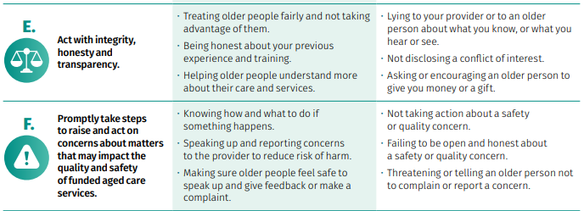
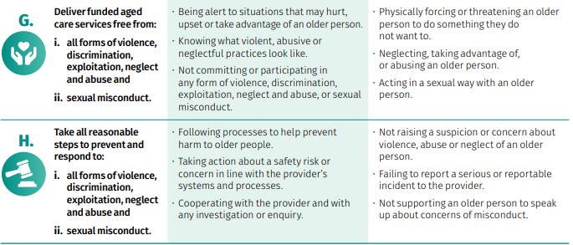
Aged Care Code of Conduct
The 8 elements of the Code

Slide 7
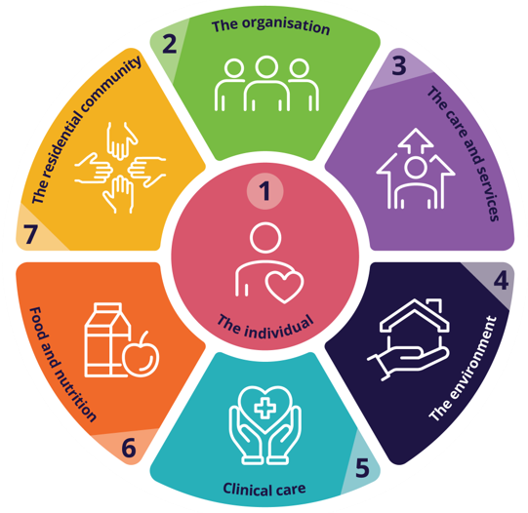
Strengthened Aged Care Quality Standards
The Strengthened Aged Care Quality Standards are a set of requirements for what quality and safe aged care looks like.
The Strengthened Aged Care Quality Standards make sure that the care older people receive:
is safe and high quality
meets their needs and preferences
upholds their rights.
The Strengthened Aged Care Quality Standards are
part of the new Aged Care Act 2024 and they
applied from 1 November 2025. These standards
are more detailed and measurable than the
previous Quality Standards.

Slide 8
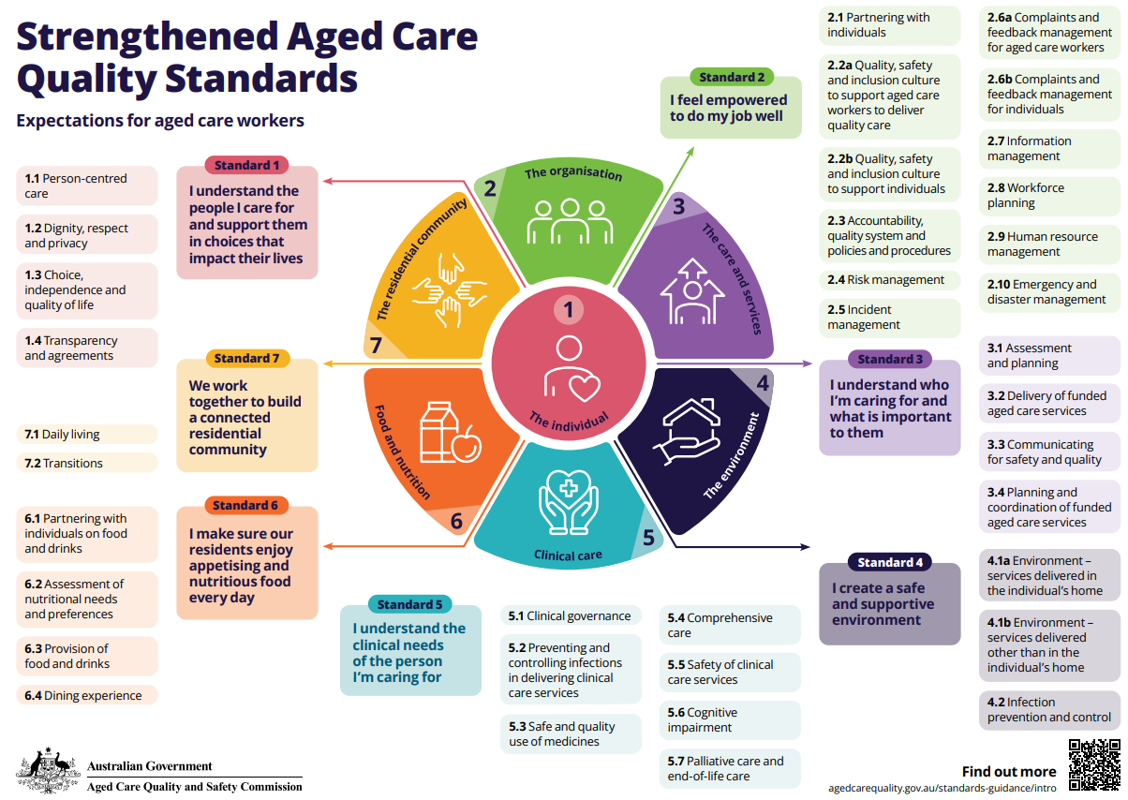
Strengthened Aged Care Quality Standards

Slide 9
Statement of Rights
About the Statement of Rights
The new Aged Care Act puts the rights of our Elders and older people first. It includes a Statement of Rights for people who receive aged care. The Statement of Rights commenced on 1 November 2025, together with the new Aged Care Act. The Aged Care Quality and Safeguard Commission makes sure all aged care providers follow the Statement of Rights.
What the Statement of Rights means to our older people
Good aged care means our people are safe and cared for the right way. It means respecting their culture, their connection to family, community and Country or Island Home.

Slide 10

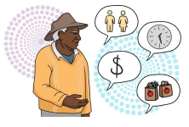
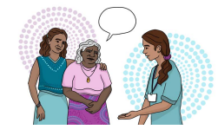
Statement of Rights
Our older people have the right to:
Have their culture and identity respected
Staying connected to Country or Island Home and community
Using their language
Practicing culture and tradition.
Make choices about their care
Having a say about who cares for them
How they spend their time and their money
What they want help with.
Speak up about their care
Say what they want or need
Speak up about what can be done better
Tell someone if they are unhappy
Ask someone they trust or an advocate to speak for them.

Slide 11
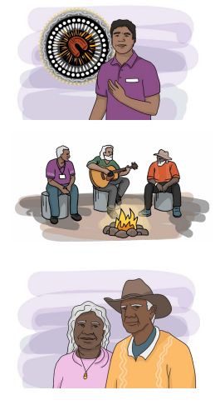
Statement of Rights
Our older people have the right to:
Be listened to and respected
People who provide care will listen to them
They will try and make things better
They don’t judge or make things bad for speaking up.
Live without abuse or neglect
Have quality and safe care that is right for them
Receive care that respects them and their identity
Not be neglected, abused or disrespected.
Have their privacy respected
Have people respect their personal privacy
Choose when their information is shared with someone else
Keep their information such as health and finances safe.

Slide 12
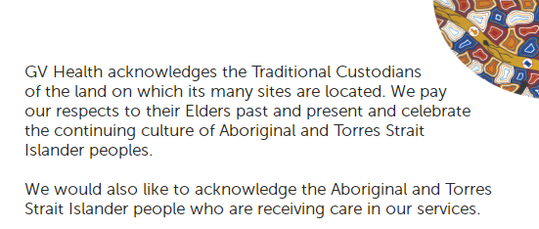
Cultural Awareness

Slide 13
Cultural Awareness
Cultural Awareness is understanding the individual differences between people of other backgrounds, races, cultures, religions or nationalities, in order to effectively communicate with people of different cultures.
In our multicultural, diverse country, cultural awareness is an essential skill for everyday life. We have a responsibility to develop awareness of all culture/s, history and traditions, in order to communicate respectfully and effectively.
Cultural awareness is important in the workplace because it ensures that a level of respect is maintained throughout all communications.
Cultural awareness in the workplace can take a number of forms. Examples include:
Knowledge of cultural responses to grief or loss
Understanding family life
Undertaking continual education in the area,
Extensive knowledge of the history of all peoples generally and in a specific area.
Cultural awareness also requires the understanding that all cultures are numerous and diverse, and that a one-size-fits-all approach is never appropriate.

Slide 14
Culturally Safe, Trauma Aware and Healing Informed care
All older people have the right to culturally safe care. Culturally safe care recognises, respects and supports the unique cultural identities of older people. This is care that is free from judgement, discrimination and racism.
Culturally safe care is particularly important when caring for older people who identify as Aboriginal and/or Torres Strait Islander persons, who may have unique cultural identities, histories and needs. It’s also important when caring for older people from culturally and linguistically diverse (CALD) backgrounds. Older people with CALD backgrounds may face language barriers or cultural differences and may have experienced discrimination.
To practise cultural safety, you need to listen and learn from the older people you provide care to and develop a shared respect, meaning and knowledge.
Practising cultural safety is an ongoing commitment. You need to be aware of your own culture, values and attitudes and how it may influence you. Only the older person receiving care can determine whether it’s culturally safe – this means you have to engage with them, listen to them and provide care in a way that they have agreed to, with their permission.

Slide 15

Culturally Safe, Trauma Aware and Healing Informed care
Trauma aware and healing informed care recognises that older people may have experienced trauma and that this can affect the way they behave. Trauma can include:
the loss of a loved one
abuse
assault
serious accidents
war
natural disasters
other impactful experiences, such as institutionalisation.
Trauma can remove an older person’s sense of safety or control. Trauma aware and healing informed care supports older people to feel safe and gives them a choice in the way care is provided. This includes:
asking permission
describing what you are going to do
receiving permission
following through in a way that is predictable and reliable.
Like person-centred care, this involves understanding and respecting an older person’s choices, preferences and life experiences.

Slide 16
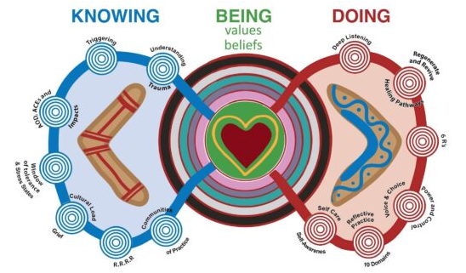
Culturally Safe, Trauma Aware and Healing Informed care
Trauma aware and healing informed care is particularly important when caring for older Aboriginal and/or Torres Strait Islander persons.
Aboriginal and/or Torres Strait Islander persons may have experienced intergenerational trauma or specific impacts related to colonisation, dispossession or systemic discrimination.
Workers should be mindful of these unique
experiences and use trauma aware and
healing informed care in culturally safe
and sensitive ways.

Slide 17
Elder Abuse
What is Elder Abuse?
Elder abuse is a single or repeated act or lack of appropriate action, occurring within any relationship where there is an expectation of trust, which causes harm or distress to an older person (WHO 2022).
Elder abuse occurs in relationships where there is ‘an expectation of trust’. Such relationships include those with family members, friends, neighbours, and some professionals such as paid carers.
In Australia, ‘older people’ are generally defined as those aged 65 and over. However, Aboriginal and Torres Strait Islander people are often included among ‘older people’ from the age of 50 (Kaspiew et al. 2015). These age groups are used to define older people in this page, unless stated otherwise.

Slide 18
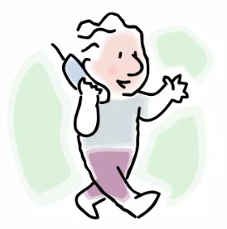
Elder Abuse
What is Elder Abuse?
Elder abuse can take various forms:
Physical – unexplained pain, burns, cuts, dislocation, sedation, repeated injury.
Psychological or Emotional – depression, confusion, insomnia, lethargy, changes in eating patterns.
Sexual – older person is reluctant to accept physical touch or personal hygiene, shows fear.
Financial – not paying bills, items going missing, no money for shopping or transport.
Neglect - poor and inadequate care or purposefully withholding of necessary items such as food / drink, untreated physical conditions, dirty living conditions or clothing, ignoring calls for assistance.
If an older person’s rights are not upheld, it is YOUR job to report this.
Your workplace will have procedures to follow when reporting a or check
with your supervisor and report to Community Interlink immediately.

Slide 19
SIRS
We all have a responsibility to help prevent
the abuse and neglect of older people
What is a reportable incident?
Serious incidents that Community Interlink must report to the Commission could be:
• Unreasonable use of force – like kicking, punching or rough handling
• Unlawful sexual contact or inappropriate sexual conduct – like stalking, making sexual advances or unwanted sexual touching
• Psychological or emotional abuse – like yelling, name calling or ignoring
• Stealing or financial coercion by a staff member – like stealing money or pressuring you to give money
• Neglect – like not giving you the care you need to stay well
• Inappropriate use of restrictive practices – like using physical force or medication to restrict your freedom or movement
• Missing consumers – where a care recipient goes missing
• Unexpected death – like someone dying unexpectedly because they did not receive proper care and services.

Slide 20
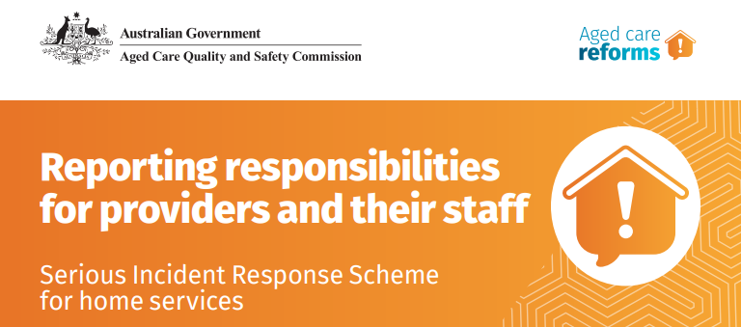
We all have a responsibility to help prevent
the abuse and neglect of older people
ALL Staff members must:
Understand their SIRS responsibilities
Be trained to respond to incidents
Escalate incidents so they can be appropriately managed and documented
Please notify Community Interlink immediately of any potential reportable incidents

Slide 21

Deteriorating Client
Notice the Signs
Deterioration is when a person’s state of health declines.
They may:
become bedbound (stay in bed);
spend more time sleeping or resting;
have reduced intake of food (eat less);
have difficulty with swallowing, or;
have a change in their conscious state
Recognising that a person is deteriorating is important so that:
this can be discussed with the person and their family;
Their care is reviewed with the person (if able), the family and GP;
a palliative care plan or pathway can be started or changed;
care is given in line with the person’s wishes;
symptoms are managed appropriately;
support to the person, the family and staff can be provided.
Support workers often care for people on a daily basis and may notice the first signs of deterioration. Please notify Community Interlink immediately of any deterioration.

Slide 22
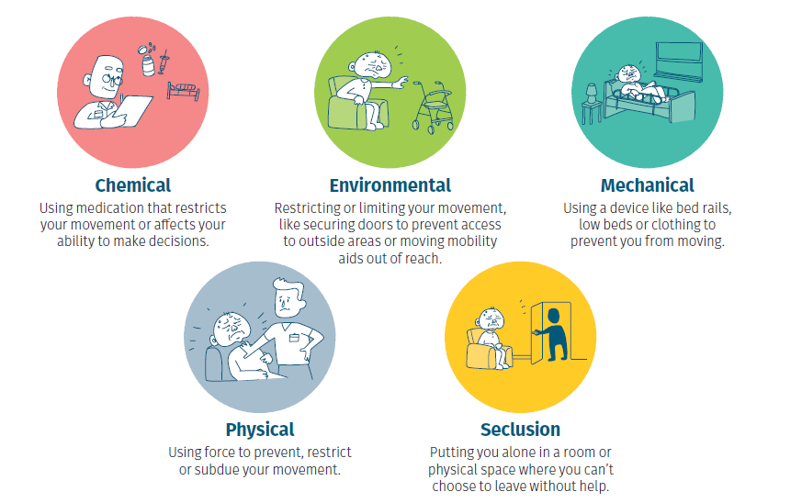
Restrictive Practices
Everyone in aged care has the right to be safe, treated with dignity and respect and receive high quality care and services.
It’s important you understand the rules around restrictive practices.
Restrictive practices limit rights or stop people from doing what you want to do.
Restrictive practices can be:

Slide 23
Restrictive Practices
Everyone in aged care has the right to be safe, treated with dignity and respect and receive high quality care and services.
Restrictive practices refer to any practice or intervention restricting the rights or freedom of people receiving aged care.
If required, restrictive practices must only be used:
in the least restrictive form
for the shortest period
to prevent harm to an aged care recipient or other people
only after careful consideration about how it may affect the aged care recipient,
And never be used as a punishment.
If you are concerned that restrictive practices are being used, please contact the team at Community Interlink immediately.

Slide 24
Open Disclosure
What is Open Disclosure
Open Disclosure is the open discussion that an aged care provider has with consumers when something goes wrong that has harmed or had the potential to cause harm to a consumer.
Open Disclosure refers to the practice of communicating with a consumer when things go wrong, addressing any immediate needs or concerns and providing support, apologising and explaining the steps the provider has taken to prevent it happening again.
Open Disclosure may also involve the consumer’s family, carers, and other support people and representatives when a consumer would like them to be involved.
Please contact the team at Community Interlink immediately if you feel there is an incident that requires the use of Open Disclosure.

Slide 25
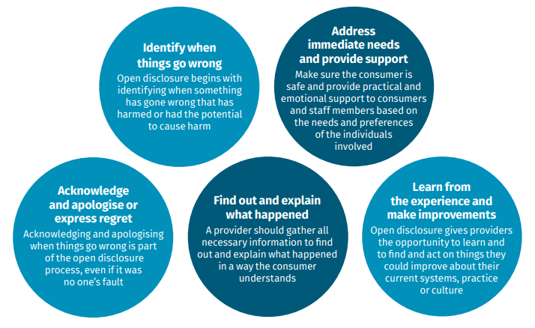
Open Disclosure
There are 5 main elements of Open Disclosure

Slide 26
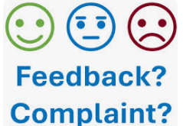
Feedback / Complaints
Aged care providers, workers and responsible persons need to make sure their services suit the needs of older people and they are acting in line with the Strengthened Aged Care Quality Standards, the Statement of Rights and the Aged Care Code of Conduct. Meeting these obligations makes sure that everyone receiving aged care is treated with dignity and respect.
What to do if you have a concern
Talking to Community Interlink about your concern can help resolve the issue quickly and improve the quality of care for everyone. It’s safe to speak up. A provider, worker or responsible person can’t punish you or treat you differently for making a complaint. If you don’t feel comfortable talking to the provider, you can speak with the Aged Care Quality and Safety Commission.
Anyone can make a complaint to us, including:
people receiving aged care
family, friends, carers and supporters of people who receive aged care
aged care workers and volunteers
health and medical professionals.
You can stay anonymous if you want. If you're making a complaint for someone else, let them know. They have a right to be involved.

Slide 27
Whistleblower reporting
The new Aged Care Act protects Whistleblowers – people who call out wrongdoing in aged care. This is to make sure older people, people who are close to them, and aged care workers can report information without fear that they will be punished or treated unfairly. People can make a report to:
the Commission
the Department of Ageing, or an official of the department
a registered provider such as Community Interlink – (03) 5823 6500
a responsible person of a registered provider
an aged care worker of a registered provider
a police officer
an independent aged care advocate.
People can make the report in person, over the phone or Email whistleblower@gvhealth.org.au
All whistleblowing reports should be taken seriously and people can choose to remain anonymous.
The report can be made about someone who has not followed the aged care law, or more broadly, about an organisation that hasn’t followed the aged care law.
If someone makes a report, they will be protected from any negative results that come from making the report and have their identities or identifying information protected, unless for example, where it is necessary to share information with the ACQSC or a lawyer, or to prevent a serious threat to a person or people.

Slide 28
Advocacy
Advocacy is defined as ‘the process of standing alongside an individual and speaking out on their behalf in a way that represents the best interests of that person’.
An advocate will assist the consumer to achieve the best outcome for them, if we cannot assist them to do so.
An advocate can:
• provide consumers with information about their rights and responsibilities
• support consumers in making decisions that affect their quality of life
• discuss consumers options for taking action
• support consumers to raise a concern or complaint with an organisation
• increase the consumers skills and knowledge to advocate for themselves

Slide 29
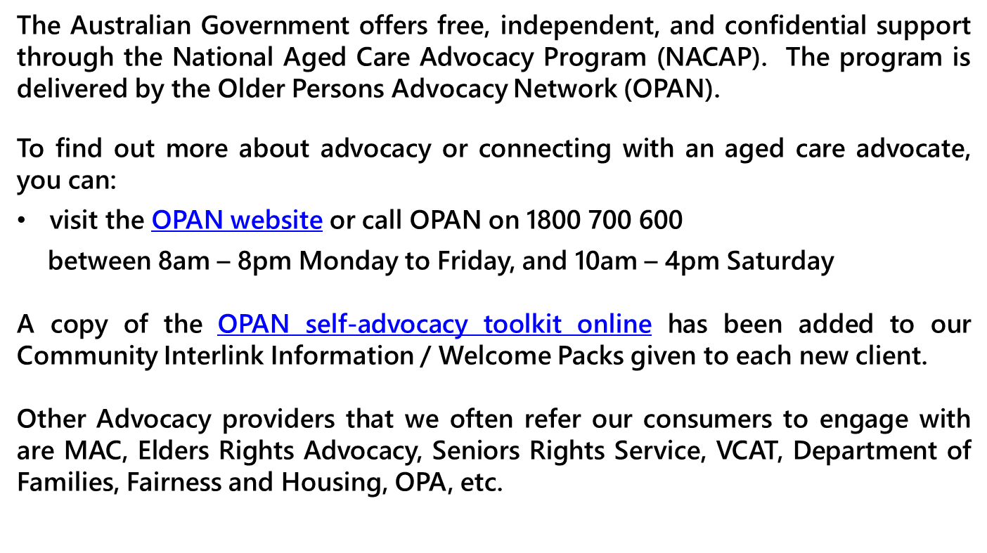
Advocacy

Slide 30
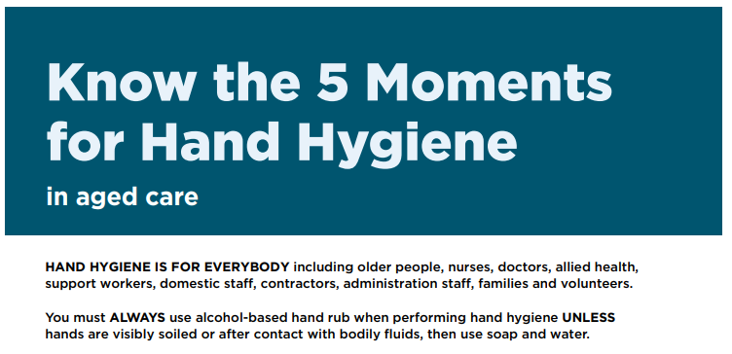
Infection Control /
Hand Hygiene

Slide 31
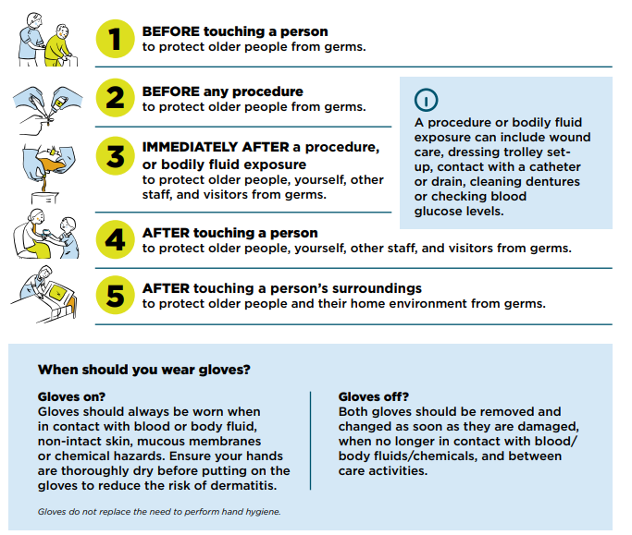
5 Moments for
Hand Hygiene

Slide 32
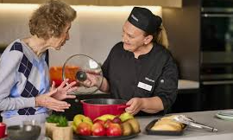
Meal requirements for in-home aged care
What providers must do
Providers must ensure meals, snacks and drinks delivered to older people through government-funded aged care services are nutritious and appetising, having regard to the older person’s needs and preferences. Nutritious meals, snacks and drinks helps prevent malnutrition and can support older people to remain independent in their own home for longer.
Providers are not required to meet every unique individual preference (such as dislike of certain ingredients). However, providers should ensure the types of meals, snacks and drinks are clearly communicated, including how they may cater to specific preferences.
For older people with specialised dietary needs,
providers must have regard for this when delivering
meals, snacks and drinks and make available suitable
menu options.

Slide 33
Meal requirements for in-home aged care
Dietitian Assessment
Providers must, at least annually, have a dietitian assess the meals, snacks and drinks delivered to ensure that any meals, snacks and drinks:
are appetising
are appropriate for the nutrition needs of older people accessing funded aged care services, including older people with specialised dietary needs
reflect evidence-based guidelines and practice.
Onsite dietitian assessment is recommended to enable assessment of texture, taste, presentation, aroma and cooking methodology. However, where access to a dietitian is limited, such as in rural and remote areas, assessment can be conducted remotely.
The role of providers is to engage a dietitian and provide information to support assessments of menus, recipes, portion sizes, cooking methods, older person feedback, photos and videos. Dietitians should assess meals, snacks and drinks against nutritional, sensory, medical, cultural and religious expectations. Dietitians will review meals, snacks and drinks using contemporary, evidence-based guidelines and practice.
Food, Nutrition and Dining Hotline: Call 1800 844 044 (Monday to Friday 9am-5pm AEST) for advice on food and nutrition, including meals delivered as part of in-home aged care settings.

Slide 34
Meal requirements for in-home aged care
Dietitian Assessment
Providers must, at least annually, have a dietitian assess the meals, snacks and drinks delivered to ensure that any meals, snacks and drinks:
are appetising
are appropriate for the nutrition needs of older people accessing funded aged care services, including older people with specialised dietary needs
reflect evidence-based guidelines and practice.
Onsite dietitian assessment is recommended to enable assessment of texture, taste, presentation, aroma and cooking methodology. However, where access to a dietitian is limited, such as in rural and remote areas, assessment can be conducted remotely.
The role of providers is to engage a dietitian and provide information to support assessments of menus, recipes, portion sizes, cooking methods, older person feedback, photos and videos. Dietitians should assess meals, snacks and drinks against nutritional, sensory, medical, cultural and religious expectations. Dietitians will review meals, snacks and drinks using contemporary, evidence-based guidelines and practice.
Food, Nutrition and Dining Hotline: Call 1800 844 044 (Monday to Friday 9am-5pm AEST) for advice on food and nutrition, including meals delivered as part of in-home aged care settings.

Slide 35

Additional Aged Care training can be found on the Aged Care Quality and Safety Commission’s online learning portal –
https://learning.agedcarequality.gov.au/user_login

Slide 36
For further questions or feedback please contact Community Interlink
on (03) 5823 6500
Links to additional Aged Care information can be found on our Website
https://communityinterlink.org.au/information-for-businesses/
Information for Businesses - Community Interlink

